Slide 1
Exploratory Analysis - Pima Indians Diabetes Dataset
Sayana Sabu

Slide 2
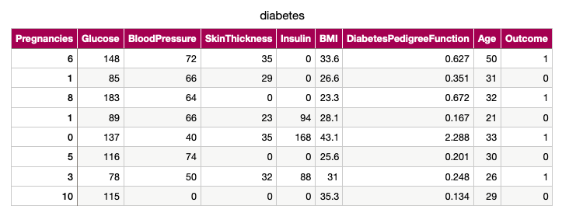
Background on the Dataset
Originally from the National Institute of Diabetes and Digestive and Kidney Diseases
A binary classifier that tells us if a patient has diabetes (1) or does not have diabetes (0) based on various factors
All test subjects were female, at least aged 21, and of Pima Indian origin

Slide 3
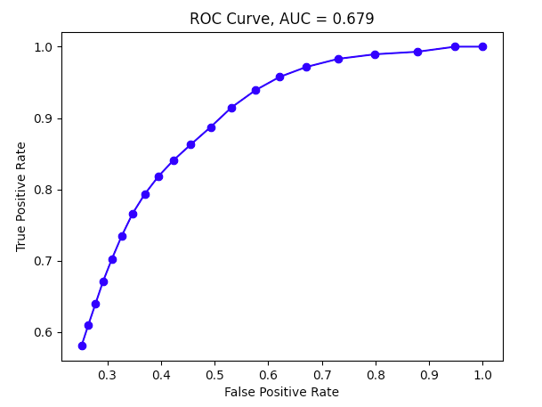
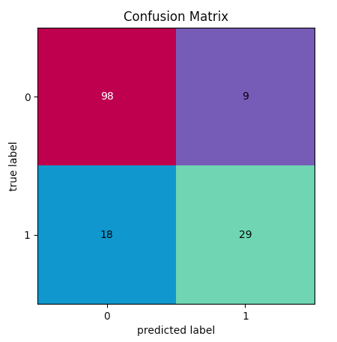
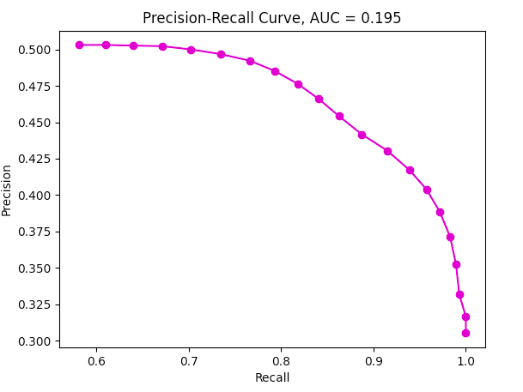
Logistic Regression
Metrics and Matrix from scikit-learn
Accuracy: 0.825
Precision: 0.763
Recall: 0.617
F1: 0.682
ROC-AUC score: 0.766
PR score: 0.588
Looping through a threshold array
Threshold array = values between [0, 1] incrementing every 0.05
Best threshold is at the point with greatest F1 score, which is t=0.65

Slide 4
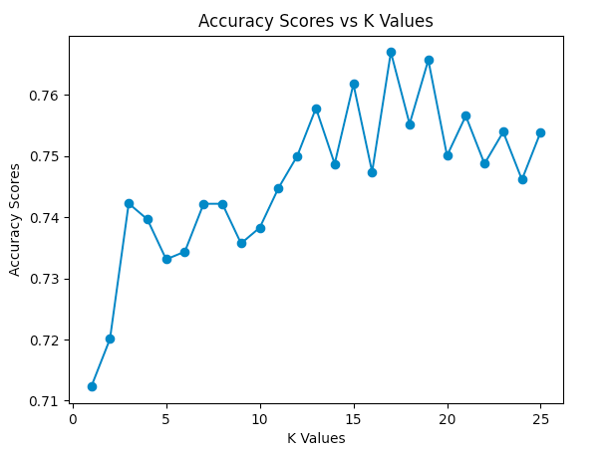
K-Nearest Neighbors
 | K = 3 | K = 5 | K = 7 | K = 17
Accuracy | 0.740 | 0.799 | 0.773 | 0.811
Precision | 0.578 | 0.682 | 0.636 | 0.725
Recall | 0.553 | 0.638 | 0.596 | 0.617
Highest accuracy occurs at K = 17

Slide 5
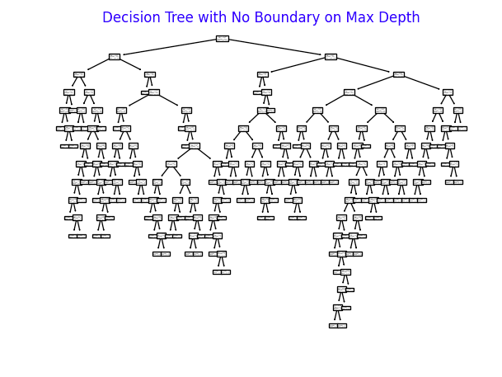
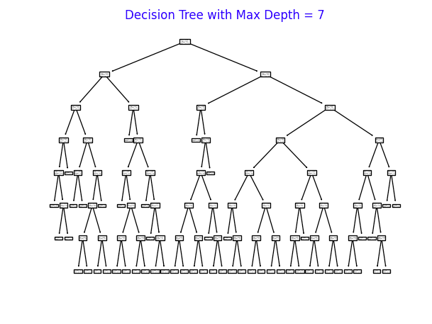
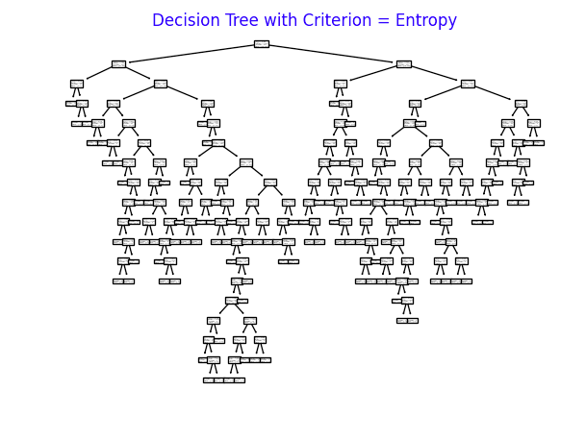
Decision Tree
Criterion = ‘gini’ | Criterion = ‘gini’ | Criterion = ‘entropy’
Max_depth = no boundaries | Max_depth = 7 | Max_depth = no boundaries
Accuracy = 0.779 | Accuracy = 0.792 | Accuracy = 0.734

Slide 6
Conclusion
In terms of accuracy, Logistic Regression provided the best result (82.5%)
It is to be noted that all accuracies obtained from all the models were roughly around the same [.73, .83]
K-Nearest Neighbors showed a tradeoff between metrics: accuracy was highest at K = 17, but recall was highest at K = 5
Decision Tree showed us that splitting criterion ‘gini’ provided the best accuracy as opposed to ‘entropy’ despite changing max_depth
As mentioned earlier, a good portion of data points were falsely classified as negative (Type II error)
This can be very misleading as it tells the test subject she does not have diabetes when in fact she does
Type I error (a false positive) is more desirable than Type II error for this dataset

